Slide 1

Water Quality Modeling and Analysis Capabilities for River, Reservoir, and Watershed Management and Restoration
UNCLASSIFIED
Jodi Ryder, PhD, Research Civil Engineer
Todd Steissberg, PhD, PE, Research Environmental Engineer
Environmental Laboratory
Engineer Research and Development Center (ERDC)
U.S. Army Corps of Engineers
Thai Royal Irrigation Visit
July 2025
UNCLASSIFIED

Slide 2
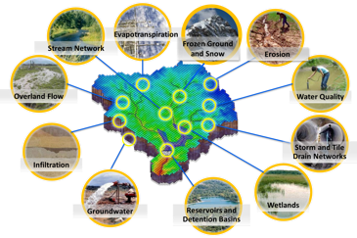
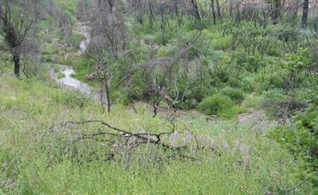
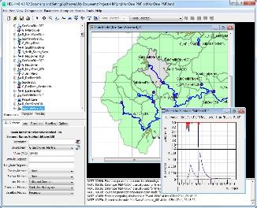
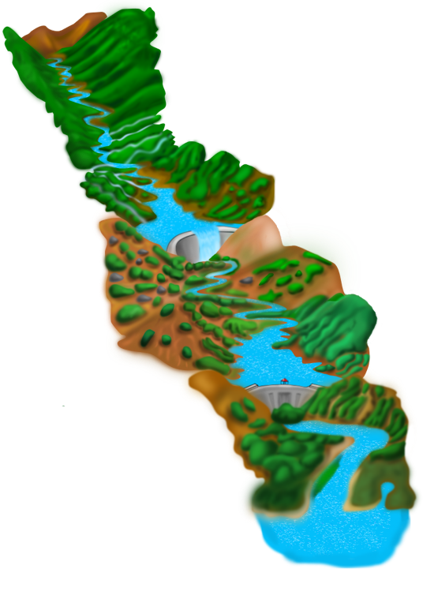
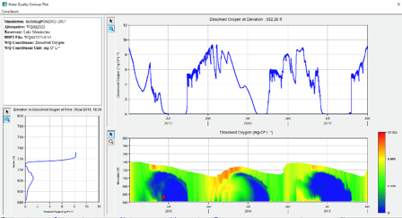
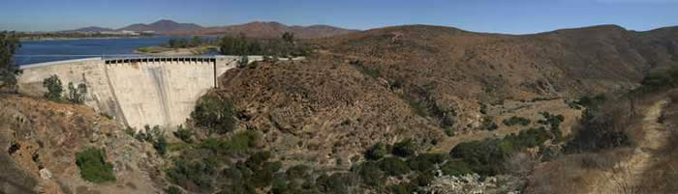
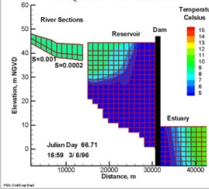
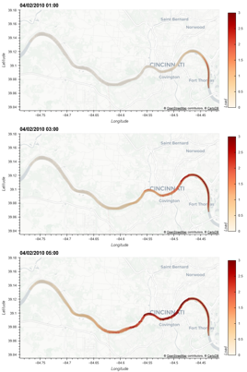
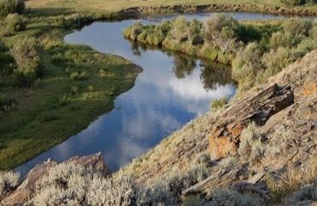
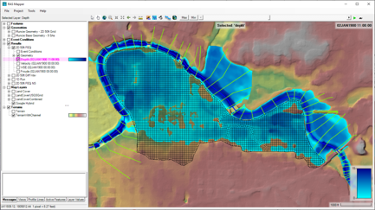
Water Quality and Environmental Systems Modeling
Temperature
Nutrients
Dissolved Oxygen
Algae
Metals
Contaminants
ERDC’s Corps Library for Environmental Analysis and Restoration of Watersheds (ClearWater) provides environmental simulation capabilities that leverage existing hydrologic and hydraulic (H&H) models.
Water quality modeling tools:
Runoff:
GSSHA: Surface and sub-surface water quality modeling
HEC-HMS: Surface runoff temperature modeling
SWAT: Soil Water Assessment Tool
Reservoirs:
CE-QUAL-W2: 2D reservoir-river hydrodynamics and WQ modeling
HEC-ResSim: Reservoir operations and water quality modeling
Rivers:
HEC-RAS: 1D River hydraulics and WQ modeling
ClearWater-Riverine: 2D River-floodplain hydraulics and water quality modeling with HEC-RAS-2D
Estuary
Key: ERDC-EL – ERDC-CHL – HEC – USDA

Slide 3
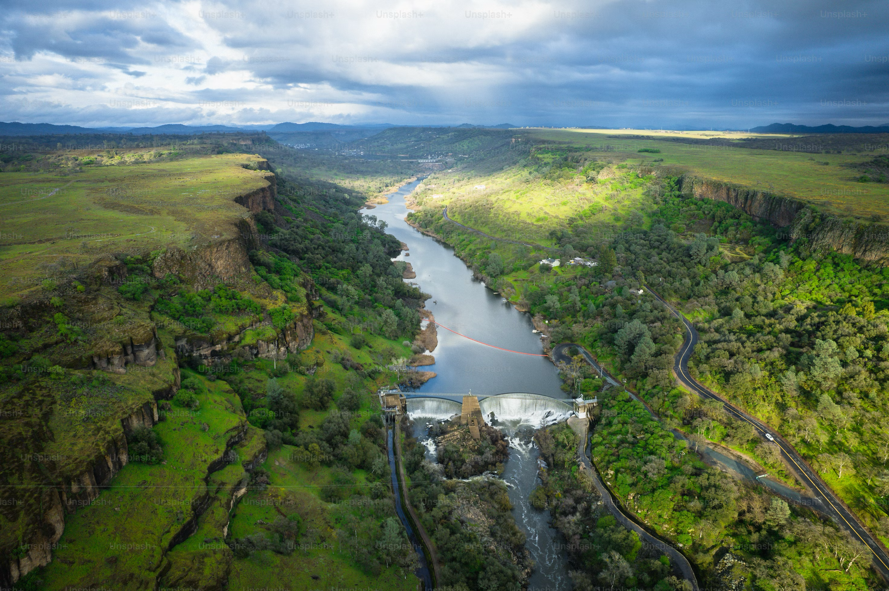
Reservoir Water Quality Modeling

Slide 4
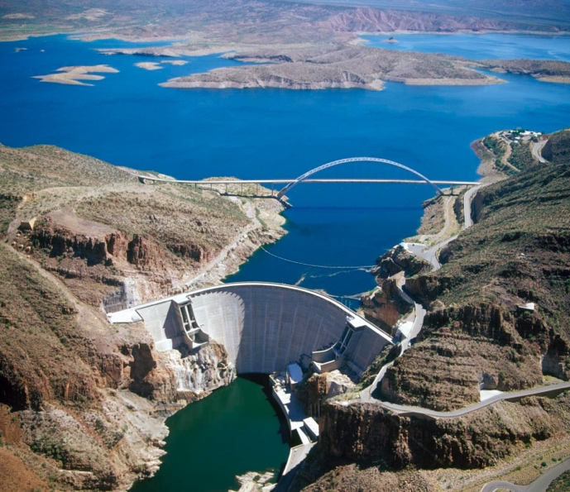
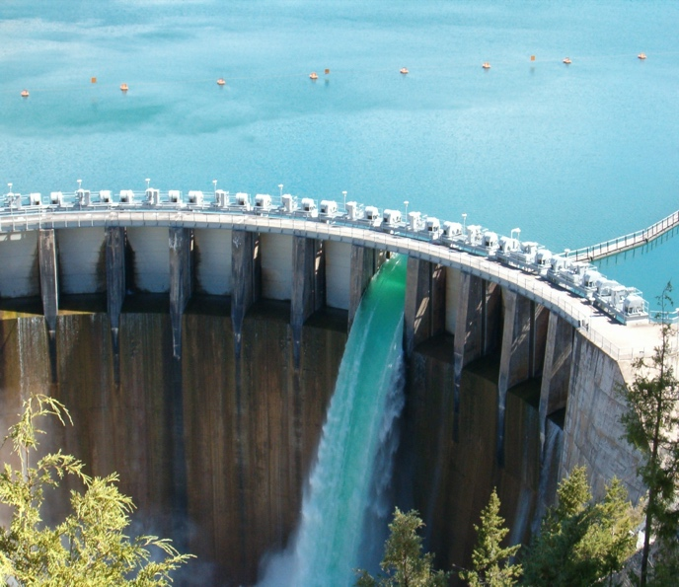
CE-QUAL-W2
CE‐QUAL‐W2 is a two‐dimensional (2D) reservoir water quality model.
Type: 2D laterally averaged model
Model grid: Vertical layers and horizontal segments.
Purpose: Simulates hydrodynamics and water quality of reservoirs and rivers. It has been applied to river-reservoir systems and estuaries.
Detailed reservoir studies
Limitations: The model assumes the reservoir is “well mixed” laterally, with no variation from one side of the channel.
CE-QUAL-W2 incorporates the following water quality capabilities:
Longitudinal-vertical hydrodynamics and water quality in stratified and non-stratified systems
Nutrient cycling
Dissolved oxygen
Algae and other organisms
Multiple algae, epiphyton/periphyton, zooplankton, and macrophytes
Fish habitat
Sediment chemistry and sediment-water-column exchange
Selective withdrawal from stratified reservoir outlets
Hypolimnetic aeration
Generic water quality groups
Internal dynamic pipe/culvert model
Hydraulic structures (weirs, spillways)
Dynamic shading algorithm based on topographic and vegetative cover

Slide 5
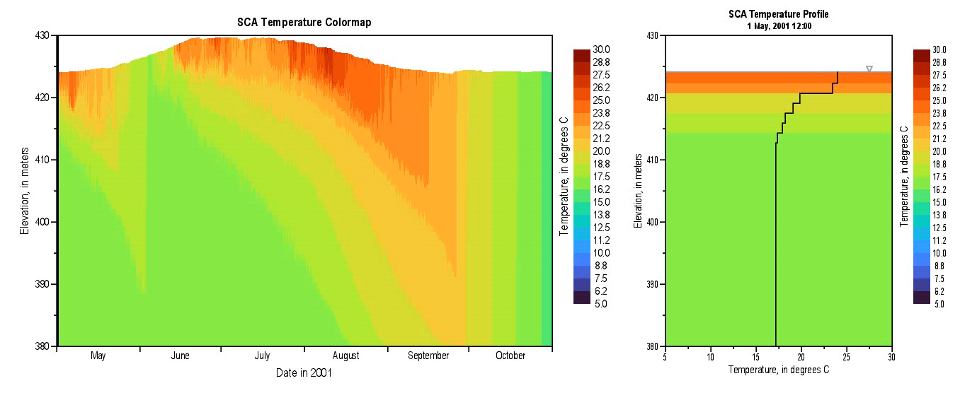
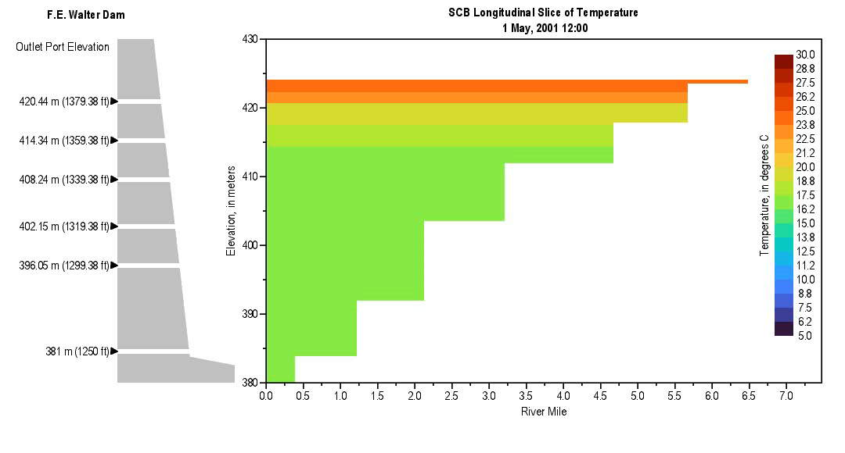
Harmful Algal Bloom Simulation with CE-QUAL-W2
Harmful algal blooms (HABs) pose a growing threat to water quality, ecosystem health, and water resource operations.
Four new capabilities were implemented in CE-QUAL-W2 to improve its ability to simulate HABs.
Minimum algae concentration enforcement
Mechanical removal of algae (e.g., harvesting)
High algal mortality under hypoxic conditions
Nitrogen fixation by algae
Benefits:
Improved HAB simulation accuracy under a wider range of conditions and treatments
Improve understanding of how various environmental factors contribute to HAB dynamics, enabling more proactive management
Improve mitigation strategies to reduce the frequency and severity of HAB events by targeting key contributing factors
Facilitate adaptive management practices
Limitations:
As a laterally averaged model, CE-QUAL-W2 cannot simulate variability across a river-reservoir channel.

Slide 6
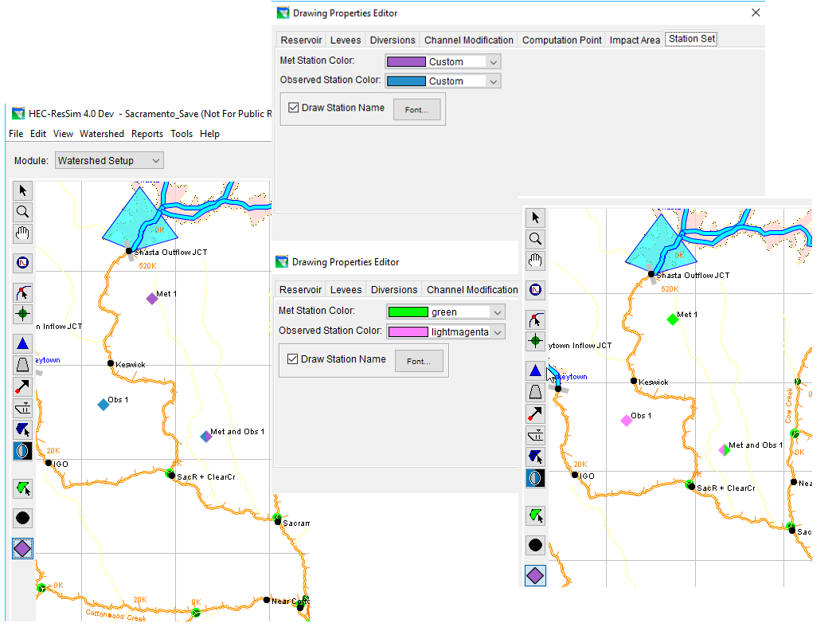
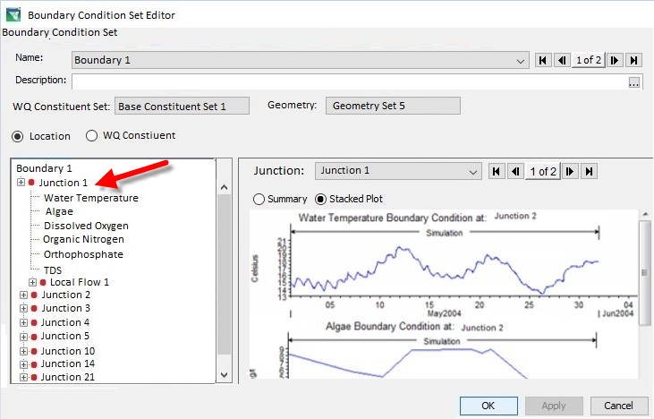
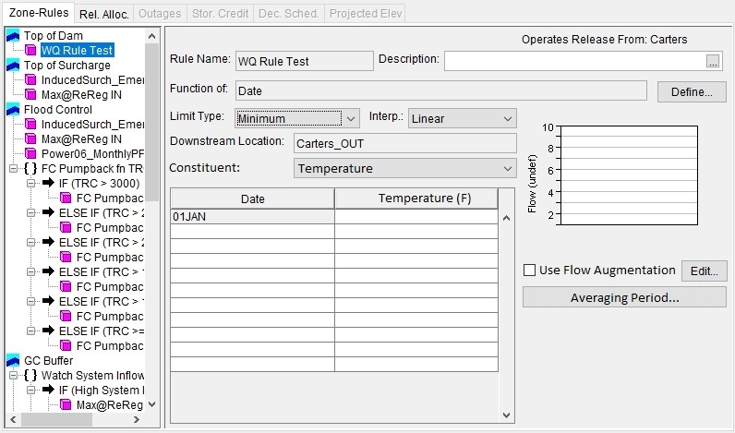
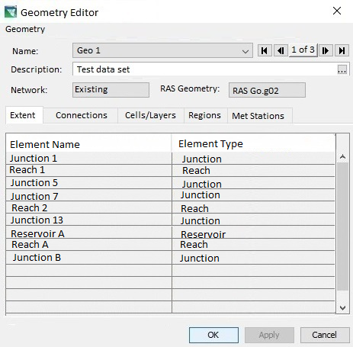
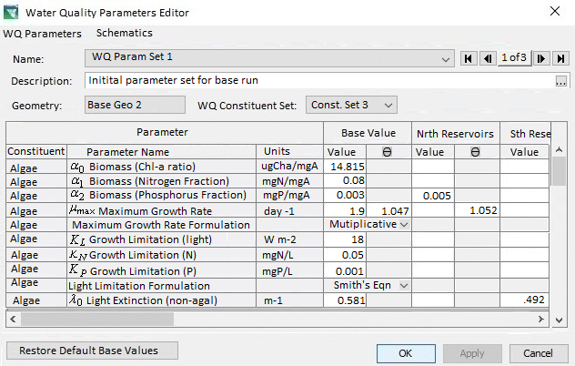
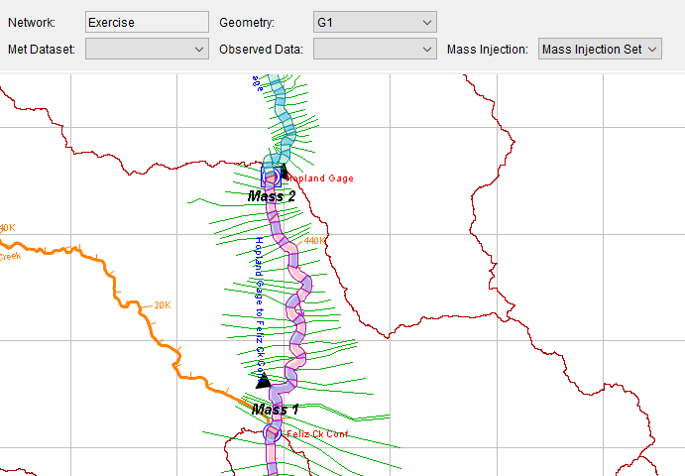
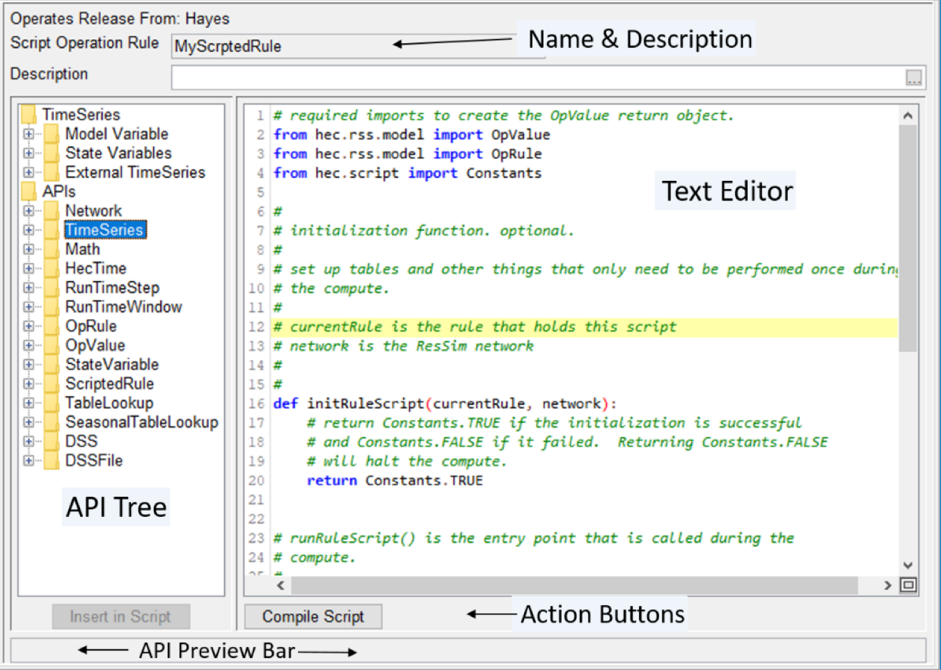
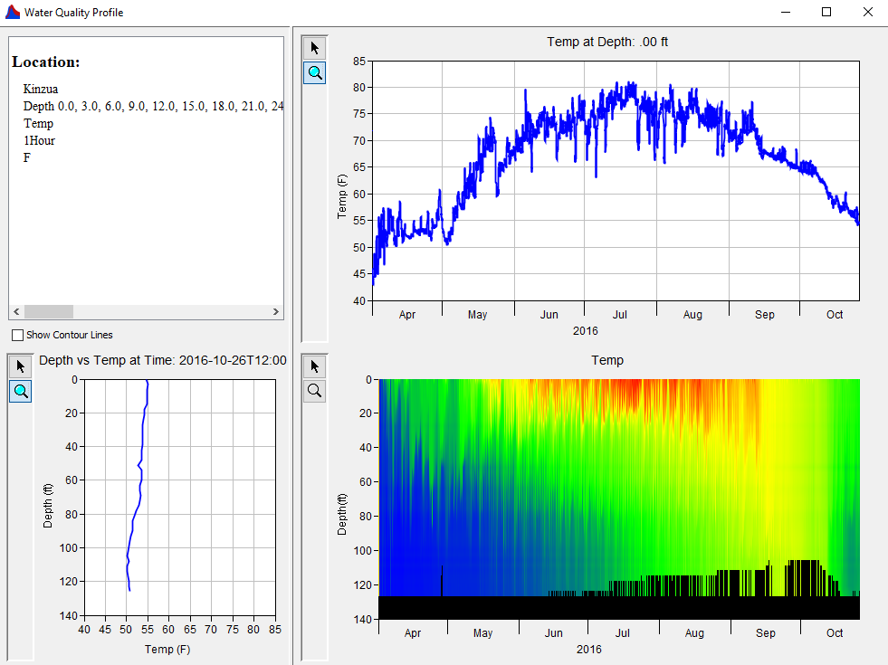
HEC-ResSim Water Quality Model (1D): Reservoir Operations
Model Geometry
Specifying Boundary Conditions
Operating Rule Priorities
Constituent Relation Parameters
Visualization
Scripted Rules and State Variables

Slide 7
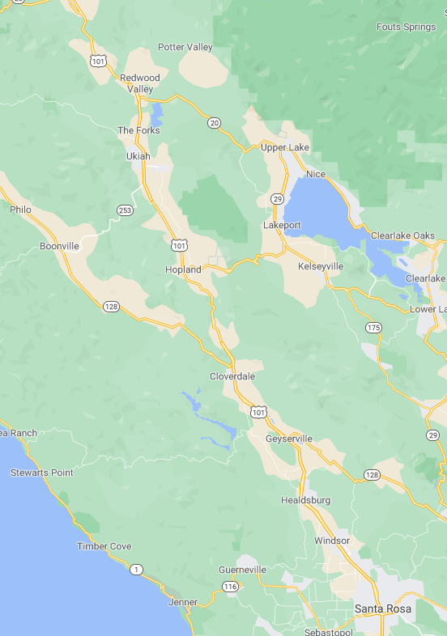
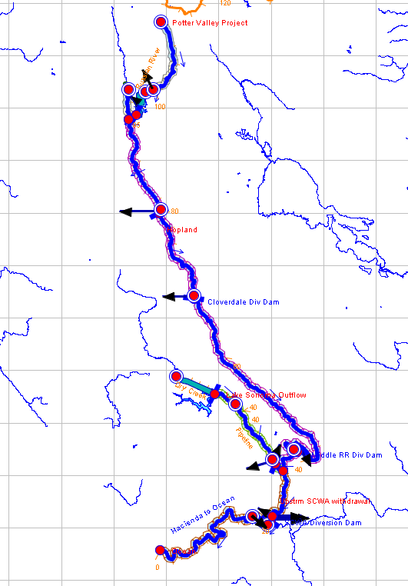
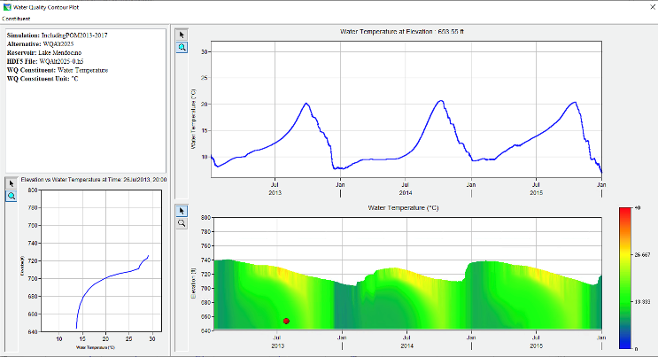

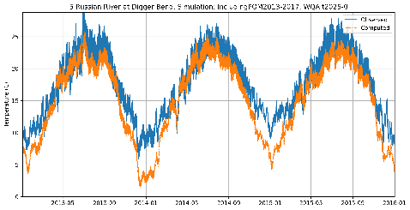
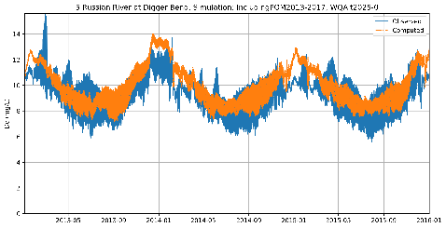
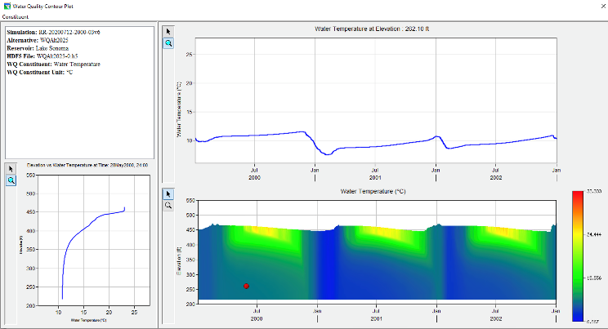
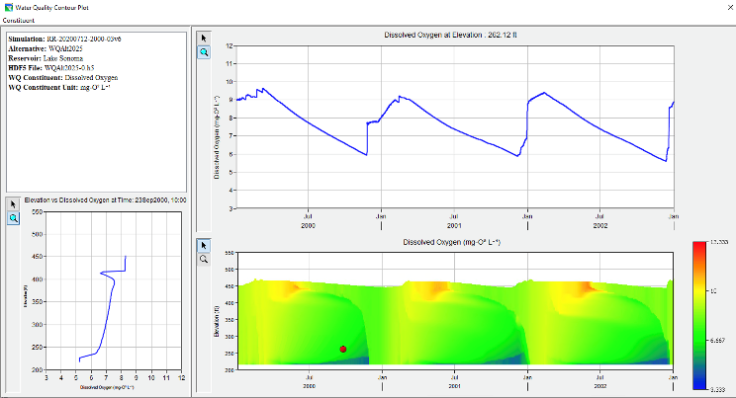
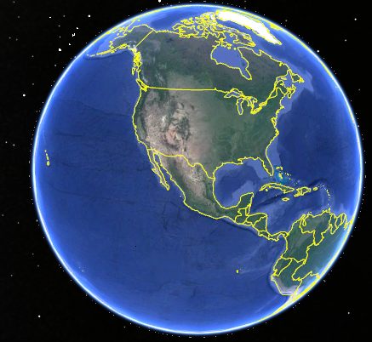
Temperature and Dissolved Oxygen Simulation with HEC-ResSim Russian River, California Prepared by RMA for the Sonoma County Water Agency
Temperature
Dissolved Oxygen
Lake Mendocino
Temperature
Dissolved Oxygen
Lake Sonoma

Slide 8
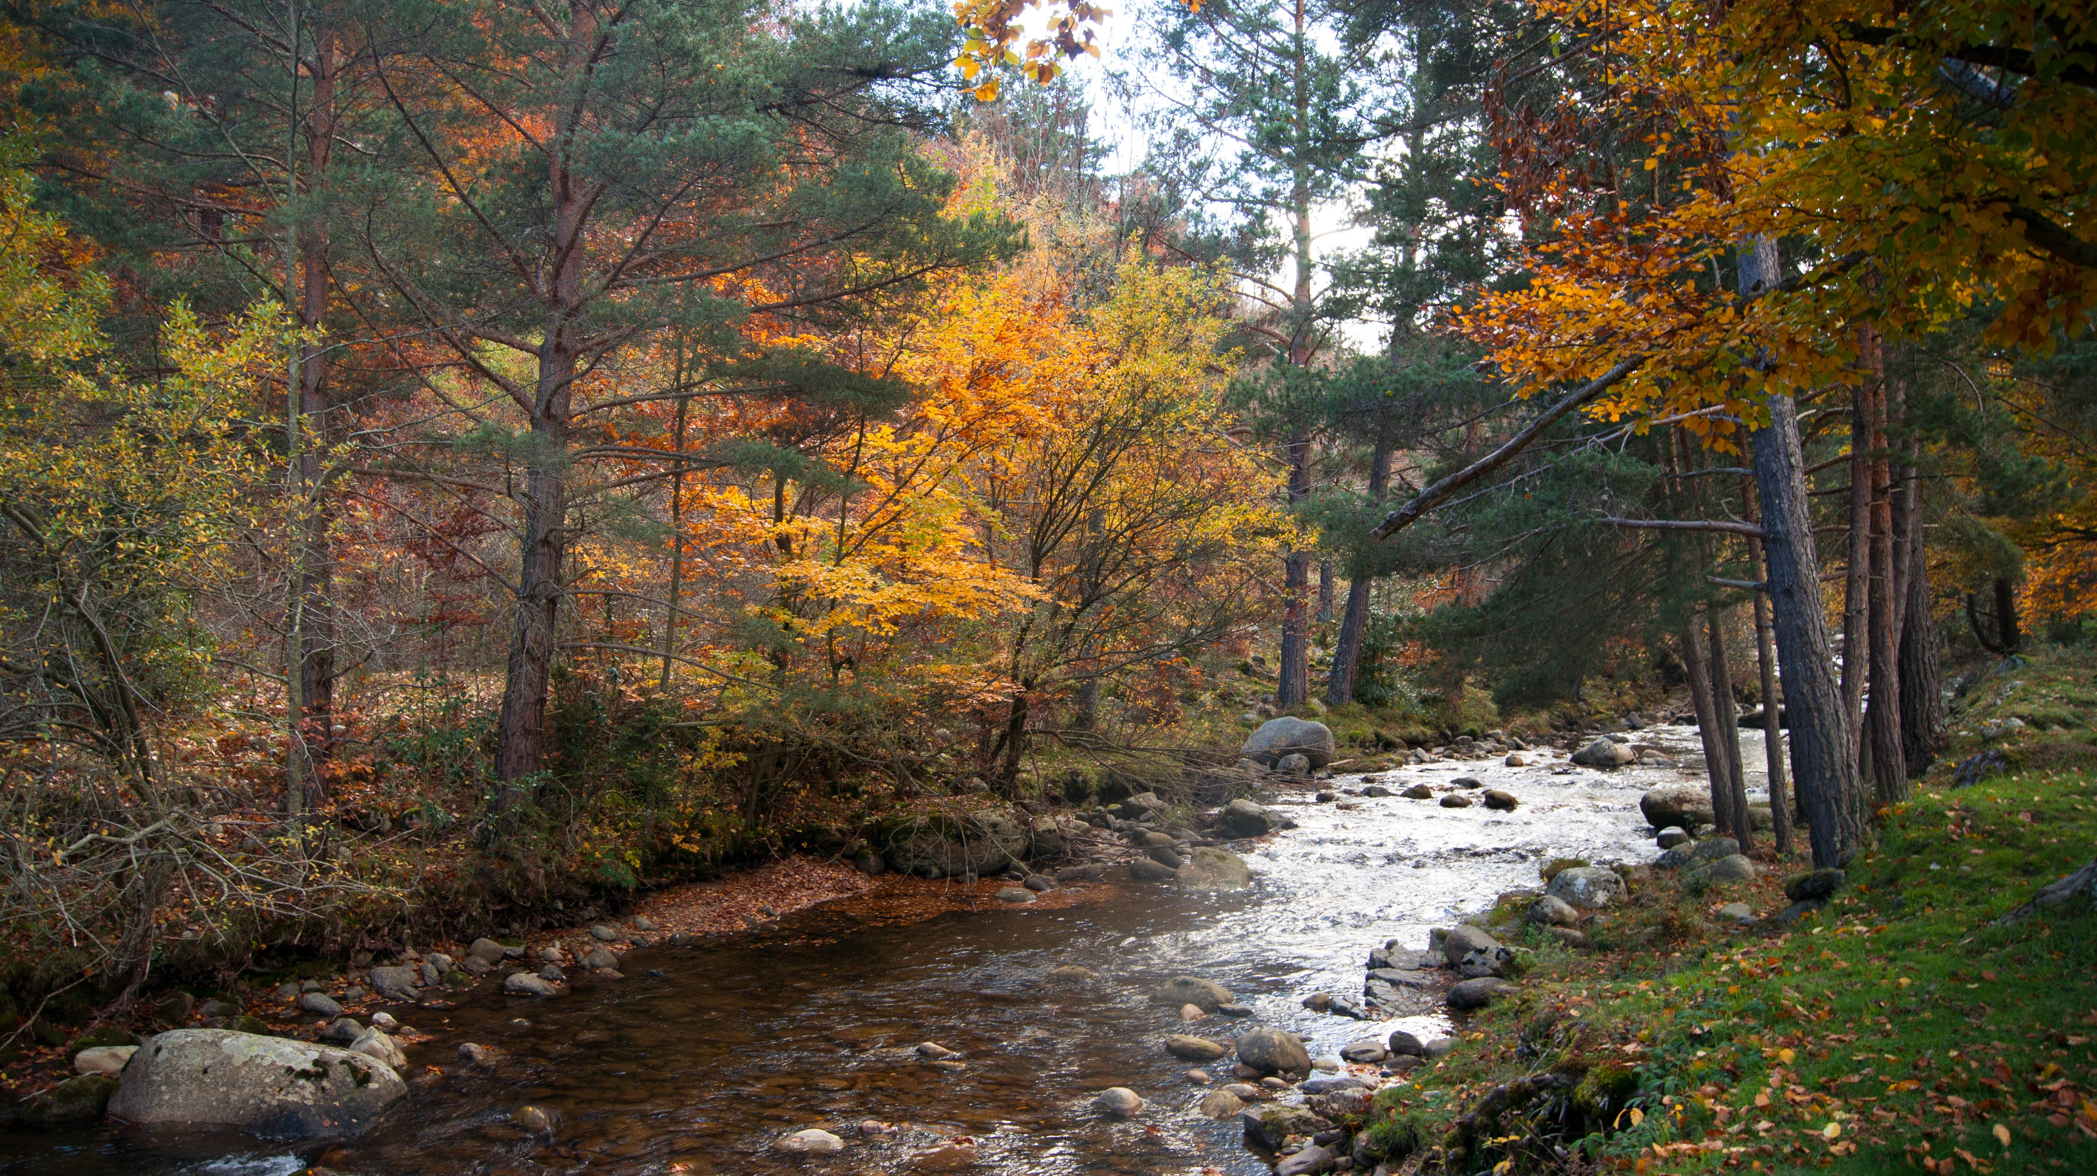
Riverine Water Quality Modeling

Slide 9
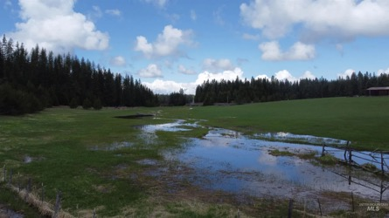
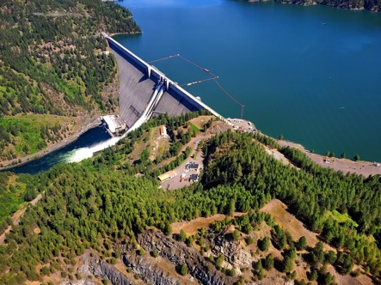
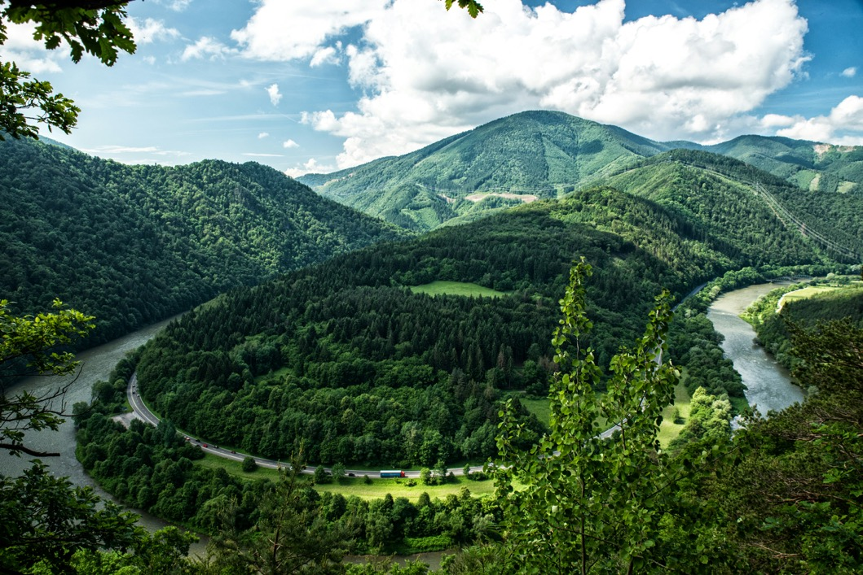
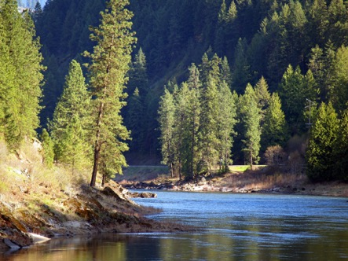
ClearWater: Next Generation Integrated Water Quality Modeling
ClearWater: Corps Library for Environmental Analysis and Restoration of Watersheds
Provides water quality capabilities that link with or extend existing water resources models.
ClearWater-Riverine is a new two-dimensional (2D) river water quality model.
The ClearWater-Riverine water quality model simulates temperature and advanced nutrient cycling in branching river systems and floodplains, incorporating hydrodynamic, water quality, and meteorologic inputs from multiple data sources and models.
It utilizes existing HEC-RAS 2D models to define the model grid and compute the hydraulic information (flows, depths, velocities).
Runoff
Reservoirs
Rivers

Slide 10
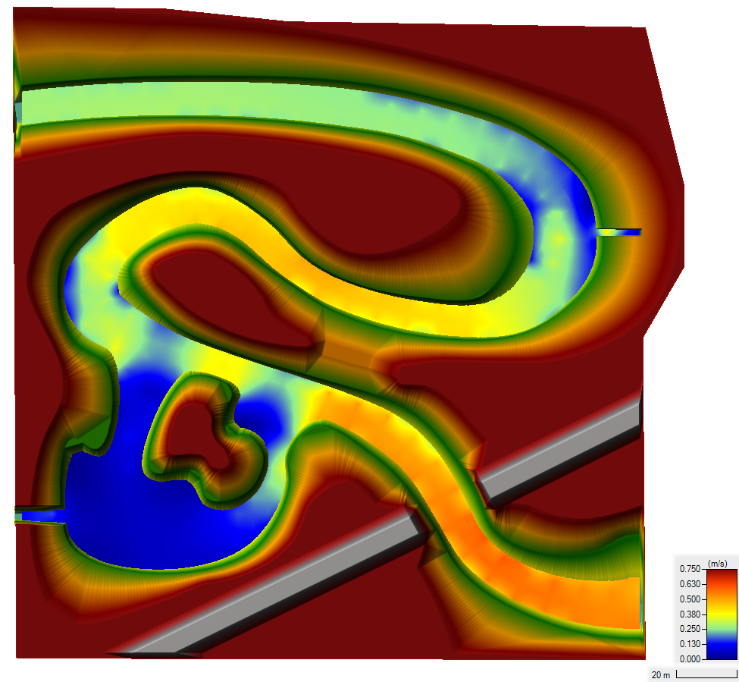
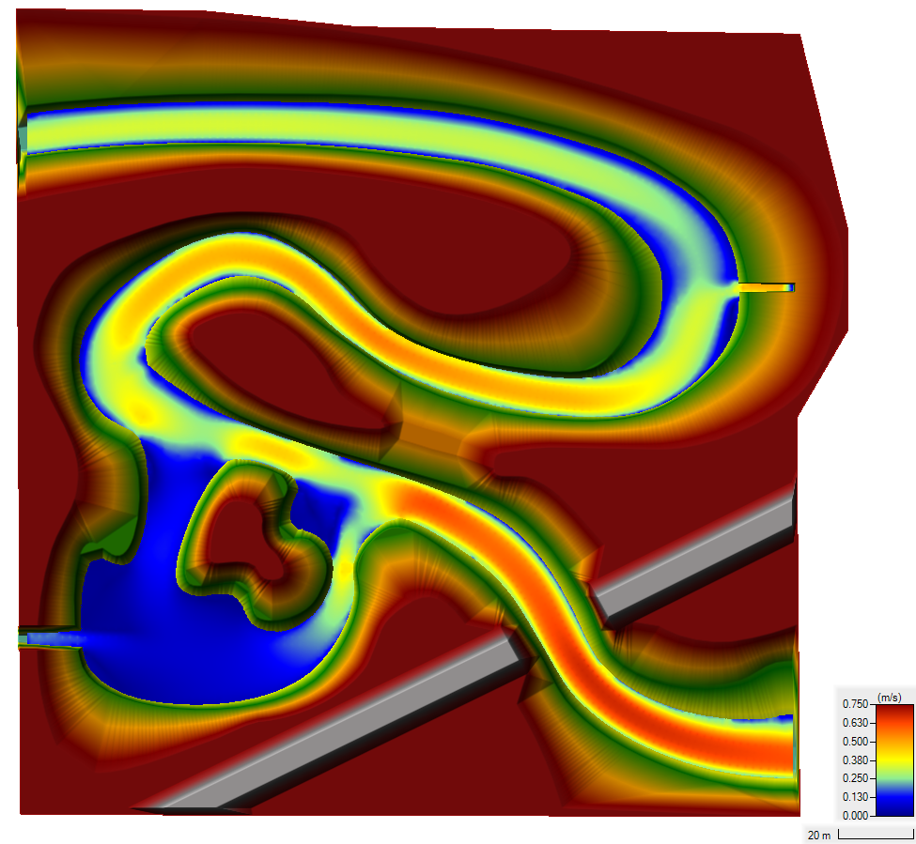
Demo Case Study: Somewhere Creek — Velocity at End of Simulation
Coarse Mesh Fine Mesh
Notes:
Differences in velocities between the meshes are due to varying spatial resolution in each mesh

Slide 11
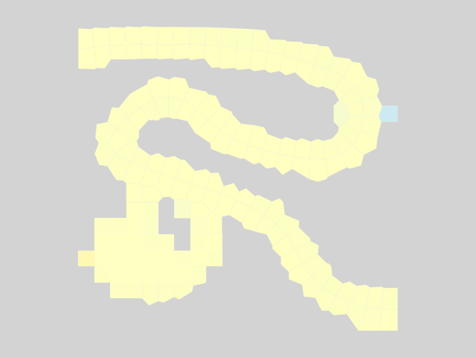
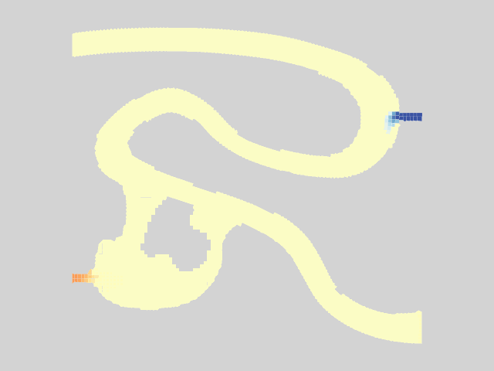
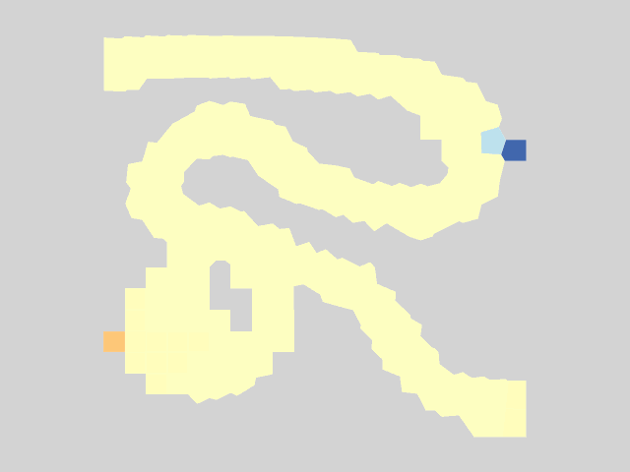
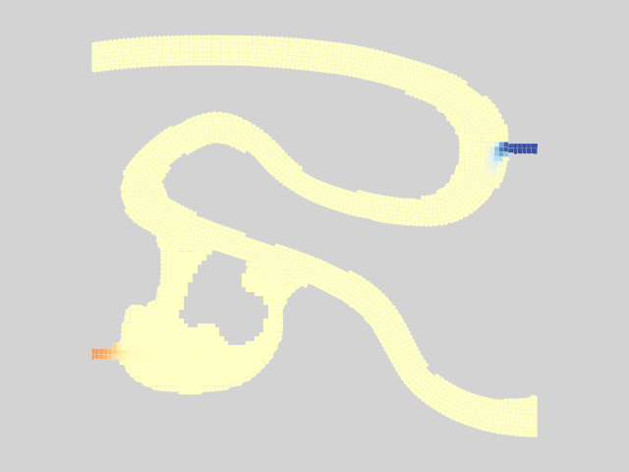
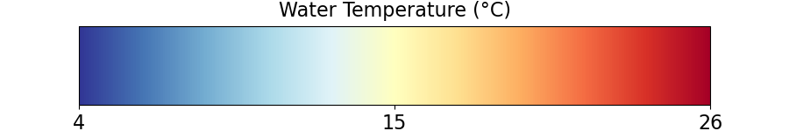
Simulated Water Temperature – Animation Inputs: Cold-Water Tributary and Warm-Water Industrial Effluent
Coarse Mesh Fine Mesh
Notes:
You can see the mixing.
Ultimately reaches steady state.

Slide 12
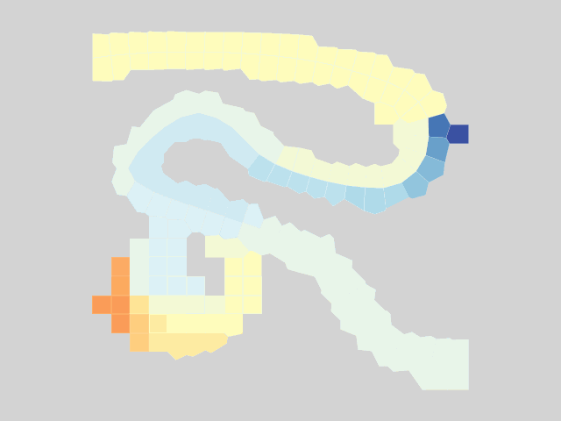
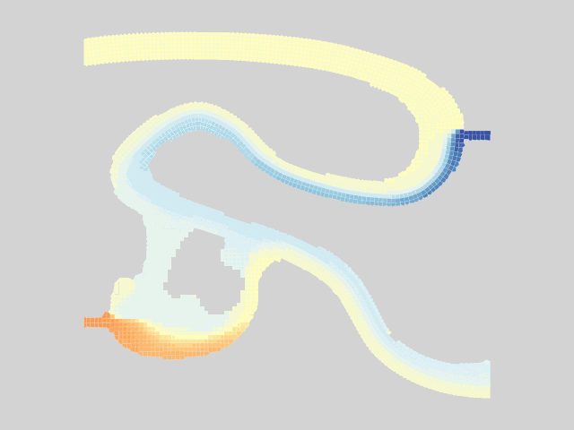

Simulated Water Temperature – Final Time Step Inputs: Cold-Water Tributary and Warm-Water Industrial Effluent
Coarse Mesh Fine Mesh
Notes:
Pulses from powerplant.
Can see a lot more transverse mixing from the powerplant and spring in the fine mesh compared to the coarse mesh.
Can see more detail on the plume of warm water.
This all shows transport very clearly, but what about our energy budget model / TSM?

Slide 13
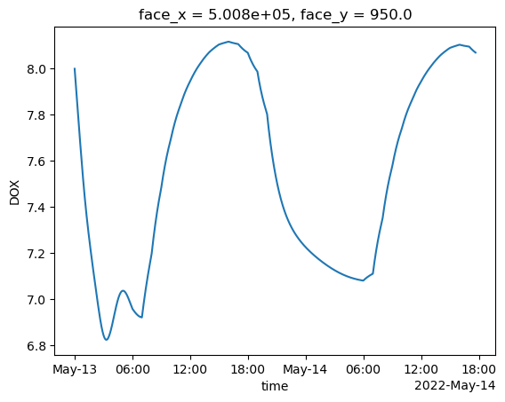
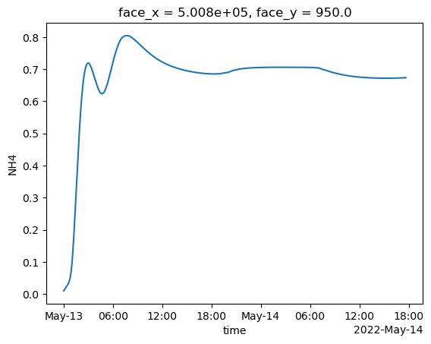
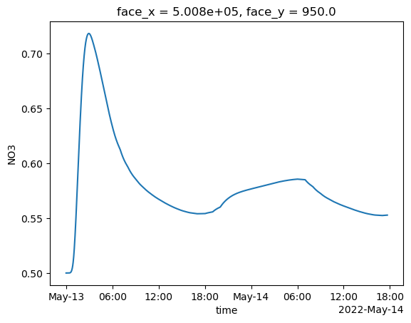
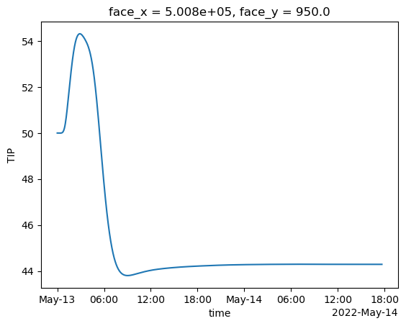
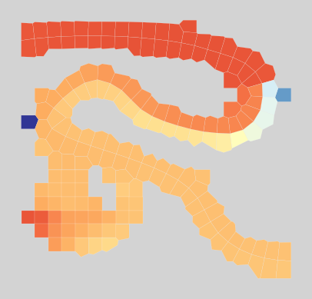



Nutrient Modeling Capabilities
Dissolved Oxygen
Ammonia (NH₄)
Nitrate (NO₃)
Total Inorganic Phosphorus (TIP)
Notes:
Pulses from powerplant.
Can see a lot more transverse mixing from the powerplant and spring in the fine mesh compared to the coarse mesh.
Can see more detail on the plume of warm water.
This all shows transport very clearly, but what about our energy budget model / TSM?

Slide 14

ClearWater-Riverine: E. Coli Transport in the Ohio River

Slide 15


Water Quality Model Application
Specific conditions
Historical events
Event impacts
HABs, Wildfires, Hurricanes
Invasive species introduction
Weather dynamics and meteorological trends
Beavers
Management decisions
New infrastructure
New operations
Specific constituents
Habitat conditions
Temperature, Salinity, DO, TDG, Turbidity
Nutrient water quality
N, P, C, S
Contaminants
Metals, organics, bio-toxins

Slide 16
Using CE-QUAL-W2 to simulate impacts of future conditions
Scenario 1 (Base): Model setup for 2013
Projected for Willamette Basin, Oregon by 2100:
Annual increase in stream temperature of 2.2°C
Annual air temperature increase of 2 - 6 °C
Increase in Winter precipitation
Decrease in precipitation during growing season
Scenario 2: Riverine inflow T + 2.2 °C
Scenario 3: Air T + 4 °C
Scenario 4: Inflow quantity +10% December-March
& Inflow quantity -10% April-July
Scenario 5: Combine all changes
Source: Oregon Watershed Enhancement Board. (2024). Region 3 Observed & Projected Climate Changes. Oregon.Gov Water and Climate Resources. Retrieved November 19, 2024, from https://www.oregon.gov/oweb/resources/Pages/Water%20and%20Climate.aspx
Notes:
The US Army Corps of engineers currently has a model setup for Detroit reservoir, which has been calibrated and validated for 2013. I’m not going to get too deep into the setup of W2, but if you’re interested in how it is setup or how we represent algae, come see me after.
The following bullets show projections for the Willamette region of Oregon released by the Oregon Watershed Enhancement board. We used these kind of as a basis for our first few run scenarios.

Slide 17


Overall changes to temperature structure
Current conditions
Projected conditions
A
B
A
B
C
C
A) Cold surface pool disappears at beginning of year
B) Higher surface temperatures earlier in the year
C) Deeper penetration of heat into water column and later turnover
Notes:
We went ahead and generated some temperature profiles to see if overall heat structure in the lake changed. The left is conditions for the normal 2013 run and the right is the projected conditions with all the combined changes. While the patterns look similar, there are a couple important distinctions to note.
Its also important to note that max depth of the reservoir increased from 105 meters to 106 meters.

Slide 18


Future projections show stronger stratification earlier in the year
More stratified
Extent of Stratification
Less stratified
2013
Notes:
In order to look at changes in reservoir stability, we have developed a stratification index. This is something that is especially important to look at for harmful algal blooms, which can be heavily dependent on stratification. If you’re interested in how we calculated this, we have a paper out in the Journal of Environmental Management.
The most important change to note occurs from February to June. At the beginning of the year there, you can see that increase in stratification from the base to the combination run. This indicates likely earlier onset of stratification for Detroit reservoir in the decades to come.

Slide 19

Impact on Algal Blooms
“All models are wrong, some are useful”
–George Box, 1976
~2 Week earlier
onset
of algae growth
Chlorophyll-a, μg/L
←Oregon action level
Notes:
The combination of the three conditions resulted in a bloom two weeks earlier, but about the same magnitude as the original. One important thing to note is that there was an influx of nitrogen into the system at the end of may, which likely prompted the original bloom. If more nutrients were available earlier in the year, especially under future conditions, its likely we will be seeing worse blooms, more towards the beginning of may.

Slide 20




Parameterizing Models
Modeling impacts of storm scour and selective dredging at Conowingo Reservoir, Maryland
Critical component is the influence of sediment on nutrient water quality in the water column
Sedflume and SBOD studies to populate model
Conowingo Dam
Upstream View
Dams on the Susquehanna River
86,490 cell Model Grid

Slide 21


Parameterizing Sediment Influence on Water Column
Grab samples for grain size distribution (Ponar)
Bucket samples for erodibility and cohesion in sedflume facility (Ponar)
Cores for vertical variation of bulk density, grain size distribution, and percent organic matter (Gravity core)
Sediment surface samples for G1, G2, G3 carbon fractions (Ekman)
Mixing sediment for BOD test

Slide 22


















Team up on Water Quality and Contaminant Modeling Solutions
Programs and Partners
USACE-ERDC-EL-EPW
Water Quality and Contaminant Modeling
Jodi L. Ryder
Jodi.L.Ryder@usace.army.mil
601-631-1852
Todd E. Steissberg
Todd.E.Steissberg@usace.army.mil
530-574-5572
Brooke S. Weaver
Branch Chief EPW
Brooke.S.Weaver@usace.army.mil
601-634-3705

